Slide 1
Residential Leasing  Property Management ©2008-2023 Copyright – Majerle Management, Inc.

Slide 2
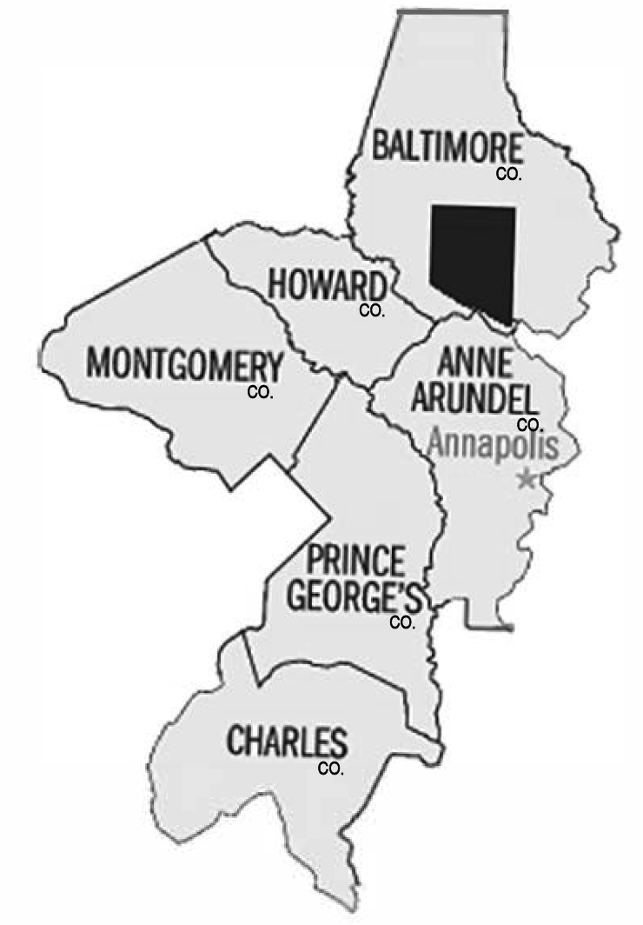
Our Service Area
MMI provides leasing and property
management services in
Prince George’s County
Montgomery County
Howard County
Anne Arundel County
Charles County
Baltimore County

Slide 3
Who is MMI?
Chris opened MMI in 1987.
MMI remains a locally-owned, locally-managed company.
MMI is a licensed brokerage specializing in the leasing
and management of individually owned rental homes.
We manage:
Single Family Homes
Town Homes
Condominiums
Small Multi-Family
Chris Majerle
CMCA, AMS, PCAM, GRI
President/CEO

Slide 4
Industry Background & Service
Chris Majerle, President/CEO
REALTOR® Emeritus, GRI, CMCA, AMS, PCAM
More than 40 years’ industry experience
Founder & CEO of MMI since 1987
Author and Instructor for MD Real Estate Commission-approved license CE class “The ABCs of Rentals”
2006 Rising Star recipient for outstanding volunteer work – Washington Metro Chapter of Community Associations Institution (WMCCAI)
2015 Public Advocate Award from WMCCAI
CURRENT
Board: Hanover Office Park Condo (past president, past treasurer)
Member: CAI Maryland Legislative Action Committee, CAI Legislative Committee
Commissioner: Montgomery County Commission on Common Ownership Communities
PAST
Chair: Prince George’s Association of REALTORS® Property Management Committee subcommittee to review and update all rental-related forms (5 years)
Chair: Greater Capitol Area Association of REALTORS ® Property Management Commitee
Member: Prince George’s Association of REALTORS® Forms Committee, Arbitration Committee
Member: WMCCAI Publications Committee and Author of numerous published articles including “Reviving your Relic” (about rescuing financially distressed community associations), “The Housing Bubble” and its effects on the Community Association, “A Hole in the Ground” about maximizing the value of a community pool
Member: CAI Maryland Legislative Action Committee
Treasurer: Middlebridge Village HOA , Hanover Office Park Condo

Slide 5
Affiliations
Prince George’s County Association of Realtors®
Greater Capitol Area Association of Realtors®
Maryland Association of Realtors®
National Association of Realtors®
Bright MLS®
Community Associations Institute®

Slide 6
LEASING
Leasing Results Are Relative to Preparation
Your MMI Property Manager will:
Recommend updates & maintenance.
Help you establish a marketable rental rate.
Administer licensing, lead testing and other requirements.

Slide 7
LEASING
Marketing vacancies is about more than just
running an ad on Craig’s List!
Effective marketing reaches large numbers of people and provides essential information… information that will excite prospective renters about your property. The more places we advertise, the more people we reach.
ARE YOU REACHING ENOUGH PEOPLE?
Once the marketing is successful and results in an application, it becomes equally important to screen applicants for income, credit and rental history.
ARE YOU PREPARED TO EVALUATE APPLICATIONS?
Our first goal is to find a qualified tenant…
…a vacancy is not in your (or our) best interest!

Slide 8
LEASING
Getting the Word Out
MRIS (the regional multiple listing system) brings your property to the attention of thousands of real estate agents. Prospective renters see photos and more than 300 fields of information.
More than 30,000 agents will have access!
Our well-recognized signs attract those who have already seen the neighborhood and the outside of the home.

Slide 9
LEASING
Your home will also appear on these widely-marketed, searchable web sites:

Slide 10
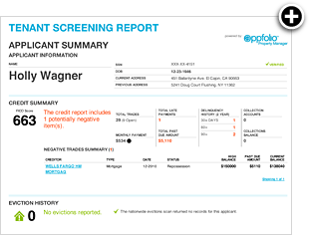
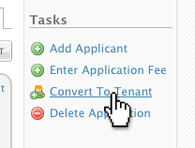
LEASING
APPLICANT SCREENING
Our Software, AppFolio, was created for Property Management and has applicant screening built right in.
Applications may be completed online.
Upon approval, we merely convert the applicant to a tenant and we are ready to receive rent.

Slide 11
LEASING
APPLICANT SCREENING
We enter resident payment history data to Experian RentBureau right from within AppFolio Property Manager.
AppFolio clients also gain access to the Experian RentBureau rental payment history data including on-time rent payments, late payments as well as information regarding skipped leases and any outstanding debts and/or collections, which is updated every 24 hours.

Slide 12
LEASING
Qualifying
Fair Housing and You
Fair Housing Laws consist of Federal, State and County/Local. Each has its own list of protected classes. Neither brokers nor owners may discriminate in the sale or rental of housing on the basis of:
· Race · Color · Creed
· Age · Religion · Gender
· Marital Status · National Origin · Presence of Children
Some jurisdictions include in the list:
· Familial Status · Source of Income · Matriculation
·Sexual Preference or Sexual Orientation
… and the list continues to grow

Slide 13
LEASING
Qualifying
Fair Housing and You
What limitations can you set?
Number of Occupants*
Pet Restrictions
Minimum Income Level
Credit Score or Worthiness
Smoking
Commercial Use
*HUD has indicated that it would not likely prosecute an owner on the basis of discrimination against families with children if occupancy limits were not set below two per bedroom.
Suggestion: When determining restrictions, restrict the behavior, not the person.
For example, prohibit smoking; not smokers.

Slide 14
LEASING
Choosing the Right Lease…
Each state, county and municipality has its own laws on rental property. Some jurisdictions require pre-approval of the lease form!
Laws are (almost) NEVER passed to protect the landlord!
So, when you use the wrong lease, you may be:
failing to include legally-required protection language for the tenant;
including tenant protections that may not be required in your jurisdiction
MMI will always use the right lease. In fact, we have served on some of the REALTOR® committees that wrote the leases.

Slide 15
LEASING
Summary of Leasing Service
Decisions will be made based on a pre-determined qualification policy which considers Fair Housing requirements, thus protecting both you and MMI against frivolous lawsuits.
We will screen your applicants through AppFolio and we will obtain, where possible, written employment and rental references.
Your lease will be written correctly and on the proper form to afford you the greatest possible protection while complying with laws protecting tenants right.
Our Leasing Fee: One Month’s Rent – includes all marketing costs.

Slide 16
LEASING
Summary of Leasing Service
Are you interested in saving money on leasing?
MMI offers the Cooperative Marketing Program
You advertise and show the property
We screen the applicants and prepare the lease
You pay only a $250 processing fee
Later, if you need help, we step in for full leasing
Still, if you find the tenant after we begin marketing, you show the property, you pay only half of the leasing fee.
Only if we find the tenant and show the property to you pay the full month’s amount for leasing

Slide 17
PROPERTY MANAGEMENT
Why did you buy rental property?
As an investment, either for its positive cash flow or anticipated future appreciation
Tax shelter
Diversification of your investment portfolio

Slide 18
PROPERTY MANAGEMENT
Positive Cash Flow requires that a paying tenant occupy the property and that maintenance costs are kept to a minimum.
Future Appreciation is enhanced by proper maintenance.
Tax Sheltering comes from the preferential treatment of long-term gains.
Diversification implies that you also own your residence, have stocks, a 401K and other investments including other types of real estate.

Slide 19
PROPERTY MANAGEMENT
It is a rule of investing that the higher the profit potential, the higher the risk.
It is our job to help minimize that risk

Slide 20
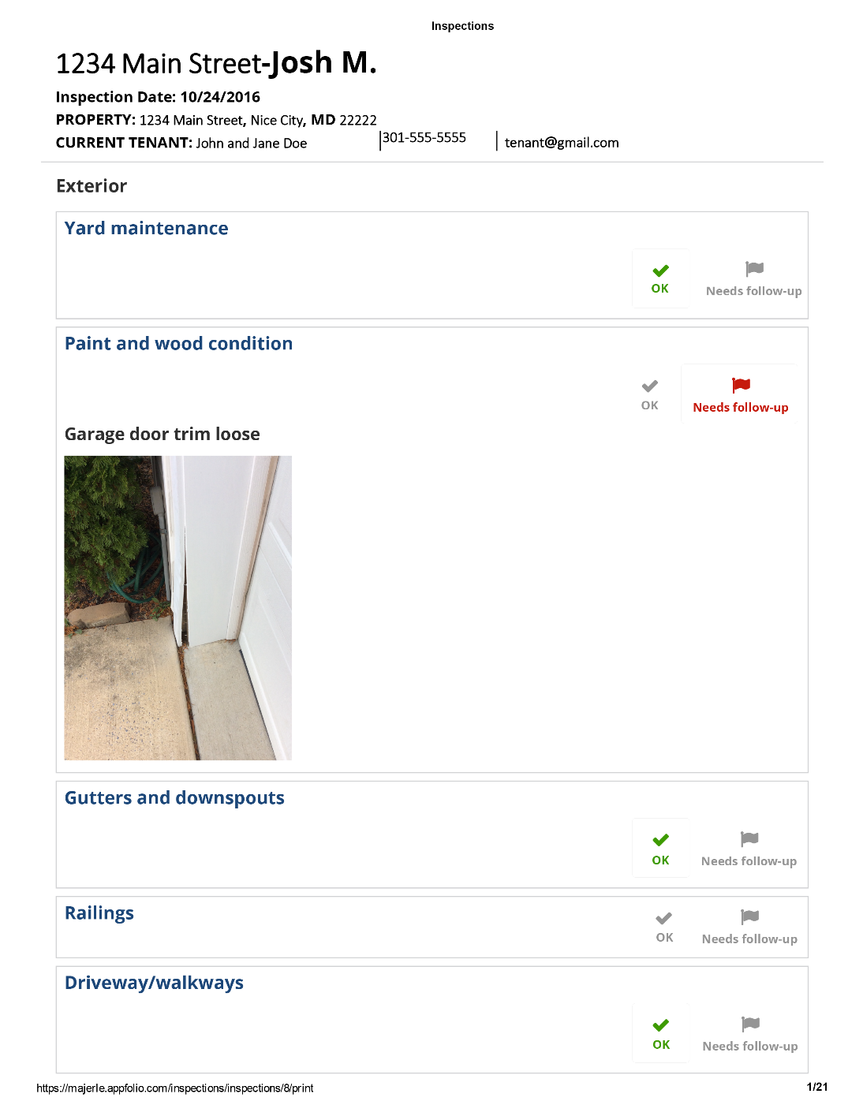
PROPERTY MANAGEMENT
We will visit your property annually.
We will look for and report property condition and defects readily visible.
Our managers will look inside and out and you will receive a written report.
Most reports today are produced on an inspection app with photo reports to enhance follow-up discussions.

Slide 21
MAINTENANCE
PROPERTY MANAGEMENT
Maintaining your investment can be the most costly and time consuming part of the equation. Let us do that for you.
Tenants call MMI 24/7 to report maintenance needs. Our operator will triage the call and attempt to properly diagnose the problem before sending a technician.
In many cases, we are able to use contractors you designate or warranties on the property or appliances.
Through Market Ready, Inc., trained maintenance staff ARE the operators taking those emergency calls. Discounted labor rates are provided to those MMI Clients who engage Market Ready for turnover services when the property goes vacant.

Slide 22
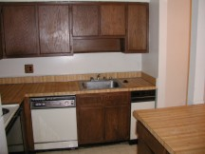
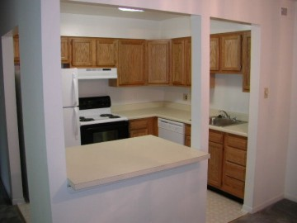
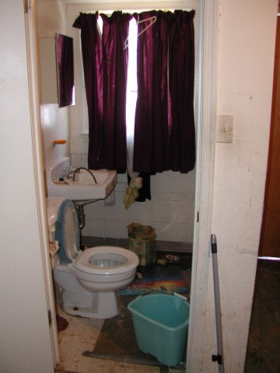
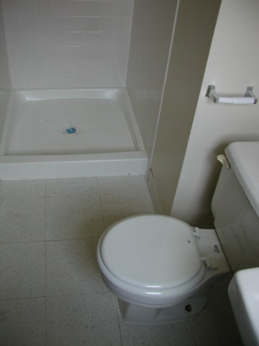
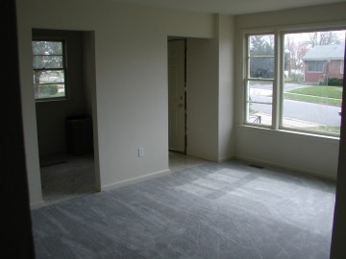
TURNOVERS
PROPERTY MANAGEMENT

Slide 23
PROPERTY MANAGEMENT
Maintenance Costs
Landlords are generally responsible for all structural components and major systems.
In some cases, repairs can be charged to the tenant. This can be done at the time of the repair or out of the security deposit following move-out.
Although the tenant may be responsible for the cost, housing code may require the owner to make repairs. We’ll review each repair bill and track and assess any appropriate charge-backs.
For accounting purposes, all costs are billed to the owner.
Recovered costs are credited to the owner, upon receipt.

Slide 24
PROPERTY MANAGEMENT
For Your Protection… and Ours.
All contractors performing work on the property must be on the MMI Approved Vendor List
MMI uses the services of a 3rd party firm to manage vendors.
They ensure:
The Vendor has the proper license
The Vendor is insured and that both you and MMI are named on the insurance
The Vendor is carrying the correct types of insurance and has adequate coverage
We are notified of any insurance cancellations or non-renewals

Slide 25
PROPERTY MANAGEMENT
Warranties and Preferred Contractors
If you designate a contractor or warranty provider, non-emergency and daytime service calls are checked against your instructions. 90% of the time, we are able to use the providers you designate.
Please remember, that leaves 10% of cases where it is simply not possible.
And, since tenants have legal rights and landlords have legal responsibilities, we do not call back the low bid, warranty contractor for essential repairs.
What about Home Warranties?

Slide 26
PROPERTY MANAGEMENT
COLLECTIONS
Tenants who do not pay are subject to legal action for possession of the property. Our attorney files these cases on a flat-fee basis.
Generally, it is not necessary for a representative to appear in court, but we will do so upon direction from the attorney.
If judgment is taken, MMI will follow-up until payment is received or the tenant is forced to vacate. We will arrange for eviction crews and lock changes if it comes to that.

Slide 27
PROPERTY MANAGEMENT
COLLECTIONS
The first step to effective collections is enabling tenants to pay!
Tenants have an online portal with links to pay by
They can also pay at any
Automatic ACH
E-Check
Credit Card

Slide 28
COLLECTIONS
PROPERTY MANAGEMENT
After a tenant vacates, charges are tallied and the security deposit is applied.
A final inspection is conducted for the purpose of determining those charges.
If the security deposit exceeds the charges, the balance is refunded to the tenant.
If the charges exceed the security deposit, a bill is sent to the tenant.
More on post-vacate collections…

Slide 29
PROPERTY MANAGEMENT
COLLECTIONS
Suits for possession are brought in the District Court. Suits for money are brought in Civil Court.
Once we determine the amount due from a former tenant, presuming we can locate that tenant, we proceed with civil action.
In order for the collections case to go forward, the tenant must be served with a summons; no service, no trial. We must be able to find the tenant to proceed with collections.
Then, you stay at work or home. We’ll be there, with an attorney, to present your case.
Want to know more about the collection process? Click here.

Slide 30
PROPERTY MANAGEMENT
ACCOUNTING
The primary purpose of accounting is to “account” to you for money belonging to you.
Our accounting is also designed to simplify your tax reporting.
You will receive two statement each month:
Cash Flow Statement
Owner’s Statement

Slide 31
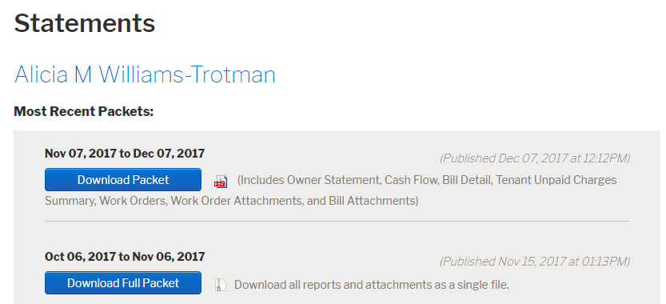
PROPERTY MANAGEMENT
ACCOUNTING
The MMI Owner’s Portal
Our owner clients visit the portal to view financial reports, inspection reports and provide maintenance funding. We use them to send same-day proceeds payments.
Alice M Thornton

Slide 32
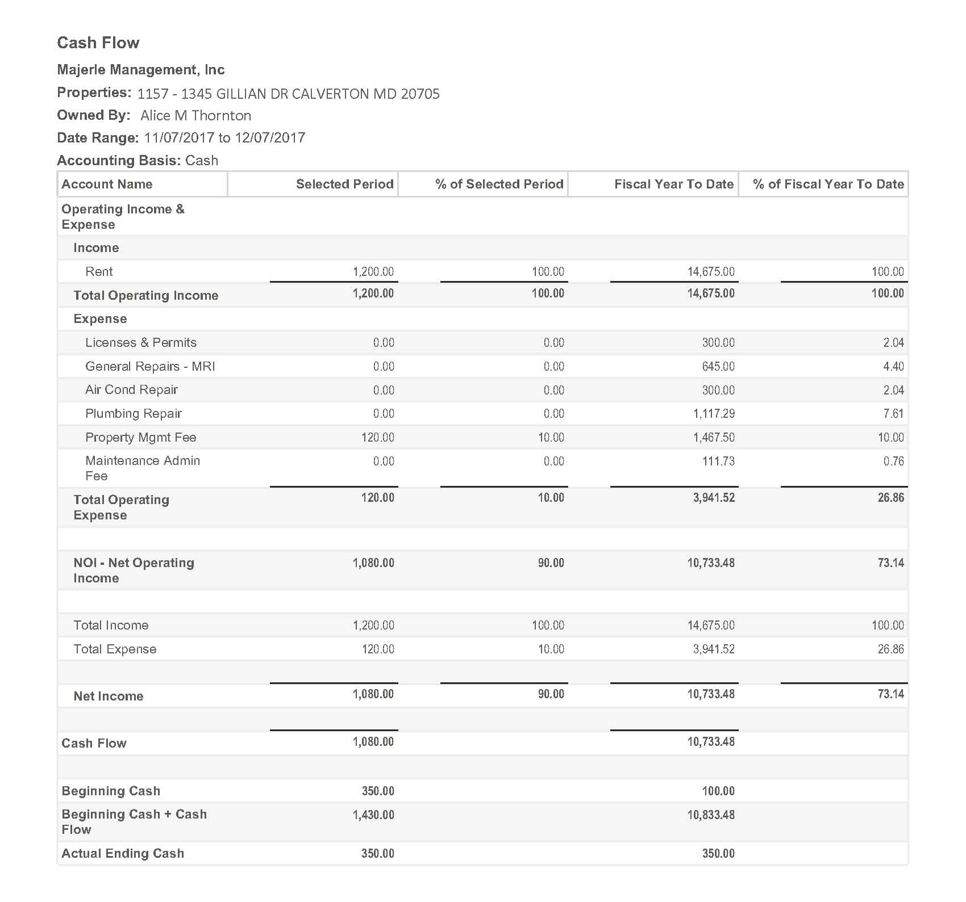
PROPERTY MANAGEMENT
ACCOUNTING
The Cash Flow Statement
Reflects current month and year-to-date figures for Income and Expenses.

Slide 33
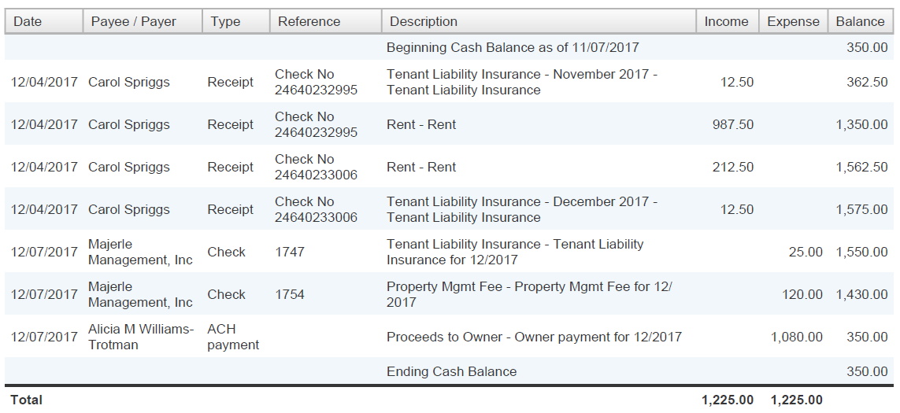
PROPERTY MANAGEMENT
ACCOUNTING
The Owner’s Statement
The Owner’s Statement lists each transaction with a running balance after each line item.
At the bottom, we would list any unpaid bills for which funds were not available. You would be asked to remit a balance.
Larry & Emma Brinks
Larry & Emma Brinks
Larry & Emma Brinks
Larry & Emma Brinks
Alice M Thornton
You always receive copies of bills with the month-end statements.

Slide 34
PROPERTY MANAGEMENT
ACCOUNTING
Owner Payments
Owners may opt to receive checks or to have their funds electronically deposited to their accounts via ACH.
At the time of disbursement, a month-to-date Owner’s Statement is issued to explain the current month’s financial activity.
Owner payments are made:
Between the 6th and the 8th
Between the 11th and the 13th
Between the 20th and the 25th

Slide 35
PROPERTY MANAGEMENT
OUR FEES
Full Service Management Fee: 10% of rents collected.
($79.95 per month minimum)
Late Fees – Retained by MMI as additional management fees.
Reserve – New properties must establish a minimum balance of $500.00.
INCLUDES
Rent Collection/Accounting (including e-payments of all types)
10% Labor discount for work performed by Market Ready
Annual Inspection with report
Vacancy turnover inspections, turn administration-No additional fees
No fee for court filings or court attendance (lawyer & court costs apply)
Eviction administration – No administrative fees
Maintenance Management – No administrative fees
License and MDE registration – No administrative fees

Slide 36
LEASING SUMMARY
Thorough Preparation
Highly Effective Marketing
Application Screening & Analysis
Proper Lease Execution

Slide 37
PROPERTY MANAGEMENT
Annual Property Visits
Maintenance Call Evaluation & Placement
Effective Collections
Comprehensive Accounting
Administrative Support

Slide 38
Getting Started
If you do not already have a tenant:
Meet with an MMI Property Manager.
Review rental comparables for pricing.
Discuss condition and possible enhancements.
Was your property built before 1978?

Slide 39
Getting Started
If you do not already have a tenant:
Complete rental listing & associated documents. (a listing is contained within the management agreement)
Arrange for lead testing (pre-1978 construction), sign, lockbox/showing.
Provide key and rental license (or application).
Your MMI property manager can begin marketing.

Slide 40
Getting Started
If you DO already have a tenant:
Execute management agreement.
Complete information sheet & other documents.
Provide lease, security deposit, payment history & relevant tenant info.
Notify tenant of change in management.

Slide 41
Getting Started
An Important Message about Insurance
If you have been residing in this property, you had homeowners insurance.
You must now change that policy to a Landlord’s Policy.
The differences: Homeowners covers your personal property; Landlord’s does not cover personal property and has higher liability premiums.
YOUR HOMEOWNERS INSURANCE WILL NOT PAY FOR DAMAGE TO A RENTAL PROPERTY!

Slide 42
Getting Started
Contact Your Insurance Agent
Or any agent of your choosing
Request a
Rental Dwelling Policy

Slide 43
Getting Started
By the way…
Your tenant will be required to have renter’s insurance.
If MMI is managing the property
Your tenant WILL have renter’s insurance.
Through AppFolio Insurance Services,
unless your tenant provides proof of coverage, coverage is automatic and billed monthly with the rent
Note: Coverage is liability only, at this time. If the tenant causes covered damage, $100,000 coverage is available at a monthly cost of $12.50. Soon, we expect coverage to be expanded to full renter’s insurance.

Slide 44
Getting Started
Be sure:
your policy contains adequate fire and extended (water/fireman damage) coverage;
the policy contains Loss of Rents coverage to replace a portion of the rent you lose during damage restoration, and;
that you have at least $1 million in liability coverage.

Slide 45
Getting Started
Finally:
Be sure your liability policy names Majerle Management, Inc. as co-insured or additional insured
(we are covered in our office and in our vehicles, but not in your home—there should be no extra cost to add MMI.)
Please ask your agent to send us a
certificate of insurance.
NOTE: Condo owners, be sure you have coverage for the Condo Master Policy deductible, which could be as much as $5,000.

Slide 46
Did You Know…
also manages
Condominium Associations
and
Homeowner Associations
Ask about
A Fresh Start for Your Community®
Chris Majerle, CMCA, AMS, PCAM
Certified Manager of Community Associations
Association Management Specialist
Professional Manager of Community Associations
If you are on your community association board of directors or know someone who might like to talk about a management change, please contact Chris Majerle at 240-387-4742 or by email at cmajerle@AccessMMI.com. Learn more at www.AccessMMI.com.

Slide 47
THANK YOU
For Considering

Slide 48
Maryland Dept of the Environment Lead-Based Paint Protection Program
Pre-1978
Mandatory participation in MDE Lead Program
Register property with MDE, pay fee
Test for lead-based paint
Dust Wipe (repeat before each new tenancy)
(Offers virtually no liability protection
Only an XRF can determine lead free status

Slide 49
Maryland Dept of the Environment Lead-Based Paint Protection Program
Since there is no protection available to landlords who participate and demonstrate that they are attempting to deliver a lead-safe property, participation and Dust Wipe testing seems only to have a value at your trial. Then, it may prove insufficient.
MMI does not recommend renting a property built prior to 1978 unless you receive a lead-free certificate… and we will not provide leasing or management services without it.
Click here to return to program

Slide 50
Home Warranties and Rental Property
What is a home warranty? General warranties are service contracts covering most major systems and structures.
How do they work? The warranty company collects money from you and tries not to spend it.
What are the economics of purchased warranties?
Some purchasers will come-out ahead. Most will not. If they did, the warranty company would be out of business. As a result, unless you have major repairs, you will likely pay more through a warranty than if you pay-as-you-go. The companies further enhance their profitability through deductibles and the use of low-bid contractors and cheap materials.

Slide 51
Home Warranties and Rental Property
What problems do they pose for property managers?
They generally have a deductible on each claim and they want a check waiting for their technician when he arrives;
They have a network of lowest bid contractors, so their workmanship leaves much to be desired;
Their contractors consider the warranty company to be the “customer,” so they often show little or no respect to our tenants or us.
Warranties: If you don’t have one, don’t buy one!

Slide 52
Home Warranties and Rental Property
Why do we mention this?
WE WILL:
Try always to use equipment warranty providers – appliances, new HVAC systems, roofing.
Make a reasonable effort to use your home warranty company for general repairs.
WE WILL NOT:
Pay a deductible in advance – you must get the company to keep your credit card on file for deductibles.
Use the warranty company for call-backs—if they don’t do the job right the first time, we’re going to get a real contractor.
Return to Program

Slide 53
Rent Collection in Maryland
Rent is due on the due date (usually the first)
Rent is late on the 2nd day—there is no “grace period”
Maryland prohibits late fees until after the 5th day (10th in Montgomery County)
Suit may be filed on the 2nd day
MMI generally files suit after 12 to 15 days. By filing later in the month, the trial is scheduled in the next calendar month. Thus, for the cost of a single suit, the judgment includes two months’ rent.

Slide 54
Rent Collection in Maryland
The suit we file is a District Court suit for possession.
The judgment is NOT for money; it is for possession on the basis of non-payment.
We cannot garnish wages or seize bank accounts—not yet.
Suits for money are filed in Civil Court. They require personal service and they take much longer.

Slide 55
Rent Collection in Maryland
Once we take judgment for possession, the court grants an automatic 5-day stay. This means we can take no further action for that 5-day period.
After the stay expires, we file a Warrant of Restitution. This is the order for eviction by the Sheriff’s Department.
We now wait our turn for the sheriff to work us into his schedule. When he does, he will give us a date and tell us how many movers will be required to execute the eviction. The landlord pays for the movers.

Slide 56
Rent Collection in Maryland
The tenant can stop the process by making payment – we are not permitted to refuse.
To stop the eviction, the tenant needs only to pay the rent covered by the judgment, even if several months have passed.
They must pay all other fees granted by the judgment including late fees and legal fees.

Slide 57
Rent Collection in Maryland
Any contact with the tenant, (personal, phone or mail), may jeopardize the case – tenants may claim arrangements have been made and the judge may believe the tenant.
MMI will not phone your tenant while legal action is pending.
You must not contact your tenant or engage in conversation while litigation is pending—if you do, we must terminate the legal action.

Slide 58
Rent Collection in Maryland
After the eviction…
We will assess damages and charge the tenant for unpaid rent and damage.
We will credit the security deposit and earned interest.
We will bill the tenant for the difference.

Slide 59
Rent Collection in Maryland
Civil Collection
If a significant balance remains, we will try to locate the tenant. If we can find the tenant, if he/she has a job, if it looks like the money is collectible, we will pursue a civil case. The attorney will charge a fee in advance plus a percentage of funds recovered.
This process may take 6 months, a year or longer. Recovery is rare. This is the reason we consider the filing of the District Court suit for possession urgent. We always file. We always try to ensure that a non-paying tenant is removed before massive debt accumulates.

Slide 60
Rent Collection in Maryland
Before we return to the program…
You must think about the legal process. We will do everything we can to prevent leasing to a problem tenant, but we can only check the past; not the future.
You must be prepared, at worst case, to suffer:
2-3 months’ lost rent before the eviction
The cost of the eviction: $200 legal fees, $500 to $1,000 movers
2-4 more months’ lost rent during repair and re-rental
Repair costs, often equal to another 1-3 months’ rent
Another leasing fee of one-month’s rent.
This is a ‘worst-case’ scenario, but if you are the unlucky one, you must be able to cover the costs or you could lose your property. We just want you to be aware.
Let’s get back to the program. Click here

